Slide 1





How to make the Contraceptive Calendar Work for You: An Introduction to Using PMA data
Notes:
Standard cover slide for external presentations; all logos displayed

Slide 2
Agenda
Overview of PMA
IPUMS’s role
Introduction to contraceptive calendars
How to re-format the string calendar data
Run the model exercise
Two breakout rooms: one for R, one for Stata
Self-select which breakout room you’d like to be in
Q&A
Conclusion
JHPIEGO
Notes:
Subscales related to .. sexual, contraceptive, and pregnancy related empowerment; financial empowerment; and decisional empowerment

Slide 3

Performance Monitoring for Action (PMA) Overview

Slide 4
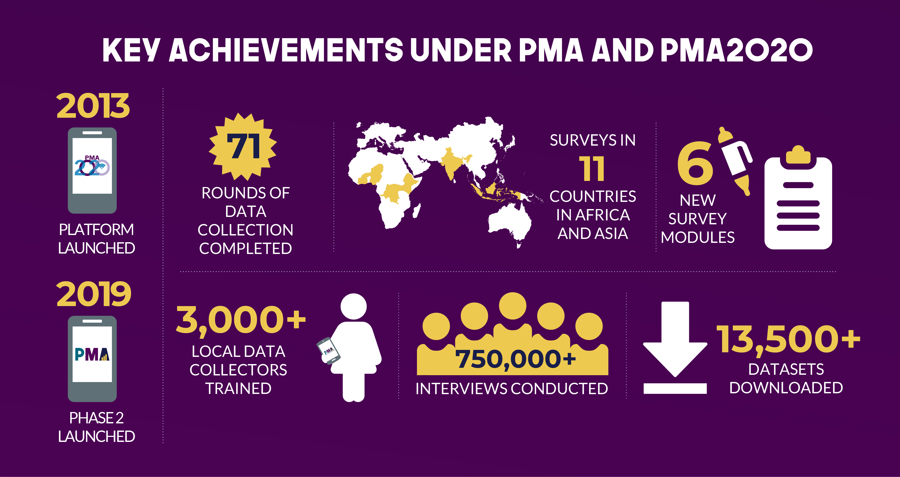

Slide 5
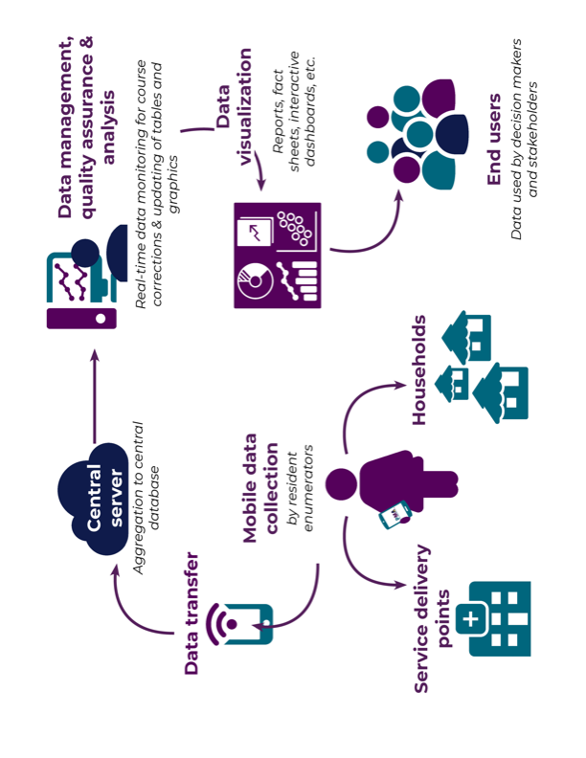

How PMA Works

Slide 6


PMA adds Panel Feature to Cross-Section
Panel Enrollment
+ Age-in
Move-in/out
+ Age-in
Move-in/out
YR1
YR2
YR3
Open Panel Design
Household
Panel
X-section + panel results
Panel results
X-section results
Linked
Linked
Linked
Private
YR1
6 mo.
YR2
6 mo.
YR3
Public
SDP
Panel
SDP interview + client exit interview
SDP + CEI
SDP + CEI

Slide 7
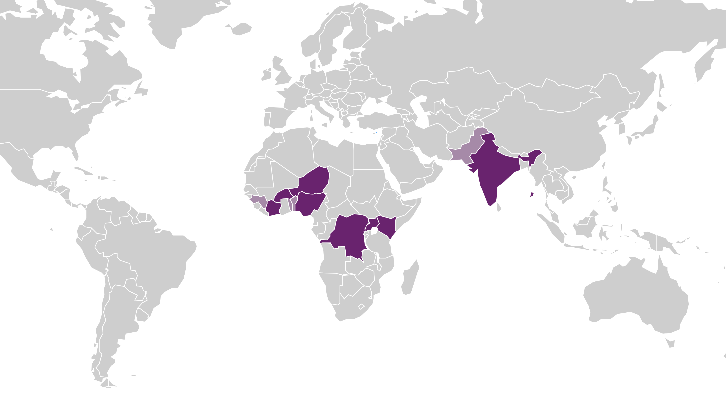
Where We Work
Countries/Partners
DR Congo | University of Kinshasa
Uganda | Makerere University
Kenya | International Centre for Reproductive Health
Nigeria | CRERD
Burkina Faso | ISSP/University of Ouagadougou
Niger | National Statistical Institute (INS)
India | Indian Institute of Health Management Research
Côte d’Ivoire | ENSEA
Ethiopia* | Addis Ababa University School of Public Health
* Under a separate grant
Notes:
Should Ethiopia be highlighted in the map?

Slide 8
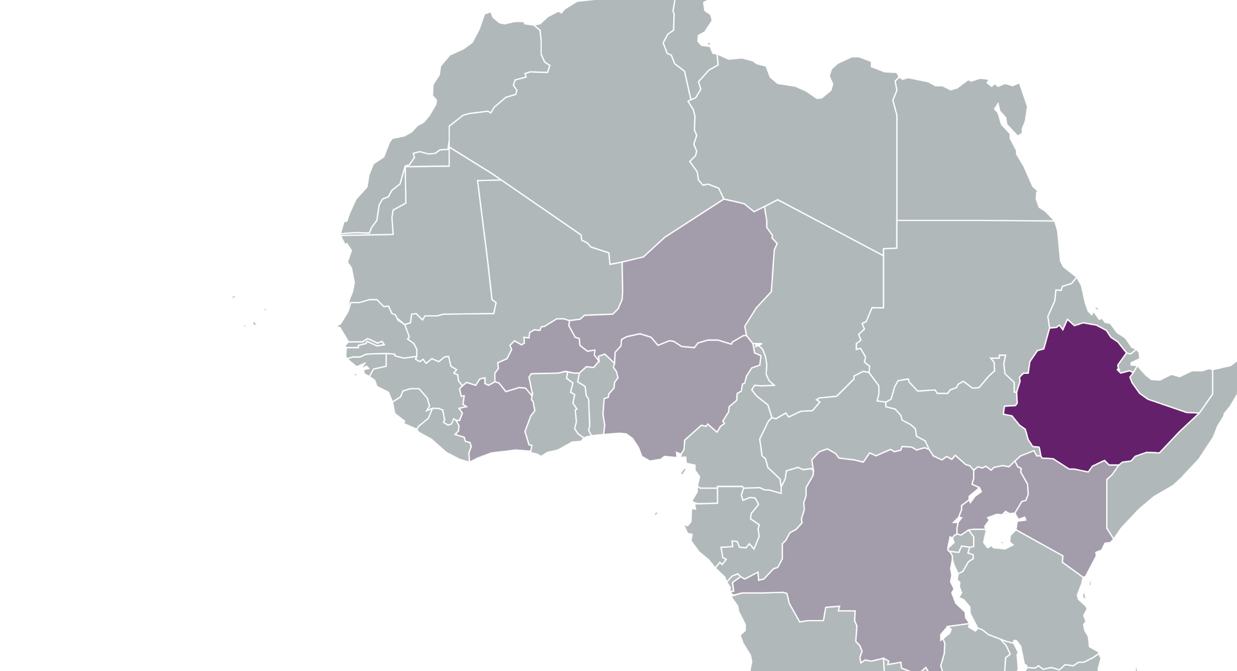
What is PMA Ethiopia?
PMA Ethiopia is a five-year project implemented in collaboration with Addis Ababa University, Johns Hopkins University, and the Federal Ministry of Health.
Nationally representative survey measuring key Reproductive, maternal and newborn health (RMNH) indicators including:
Antenatal, delivery, and postnatal care
Vaccination attitudes and coverage
Modern contraceptive prevalence
Reproductive empowerment, fertility intention, and community norms
Health facility readiness and quality of care

Slide 9

Conceptual Framework for PMA Contraceptive Dynamics Panel
Overlay:
Adolescent & Abortion modules
+
Changing FP Norms
Service Environment
Supply
Method Choice
Readiness
Adolescent-specific questions
Contraceptive Use Status
Continuing use/non-use
Discontinuing
Adoption/PP adoption
Switching
Background Characteristics
Individual-Household
Community
Context
Empowered Decision Making
Reproductive Intentions
+
Service
Quality of Care
Counseling
Achievement of reproductive and life course intentions
Women’s perception of community norms; composite of personal
beliefs
Women and girls empowerment scales; economic empowerment; employment
Want child now/later/no more; aspirations, contraceptive intentions, personal attitudes on contraception/FP
+
Outreach
BCC/IEC
CBD-Mobile
Changing Empowerment
Changing Intentions

Slide 10
New Content since PMA2020
Women and girls empowerment migration
2 year contraceptive calendar (!!)
Personal attitudes and community norms
Adolescent/early adulthood questions
Client exit interview
JHPIEGO
Notes:
Subscales related to .. sexual, contraceptive, and pregnancy related empowerment; financial empowerment; and decisional empowerment

Slide 11
IPUMS: What We Do

Slide 12
What is IPUMS?
IPUMS provides census and survey data from around the world integrated across time and space. IPUMS integration and documentation makes it easy to study change, conduct comparative research, merge information across data types, and analyze individuals within family and community context. Data and services available free of charge.

Slide 13
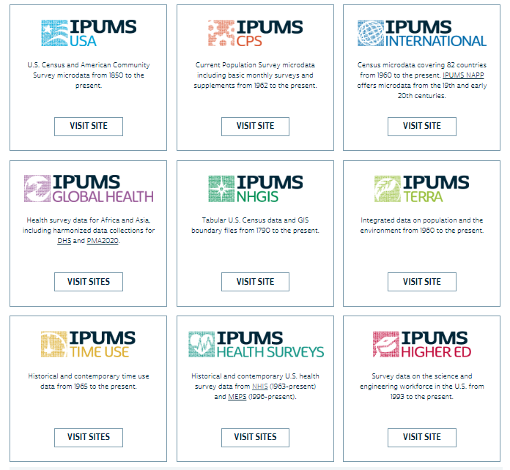
Notes:
what do we do? – brief introduction to each of the projects

Slide 14
IPUMS PMA
Harmonize codes and variable names
Document variables
Disseminate custom data files in multiple formats
Adds calculated fields

Slide 15
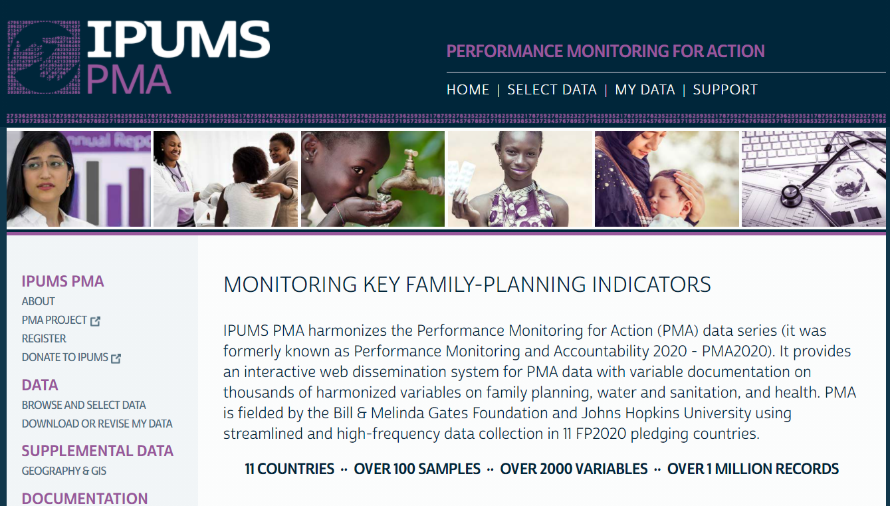

Slide 16
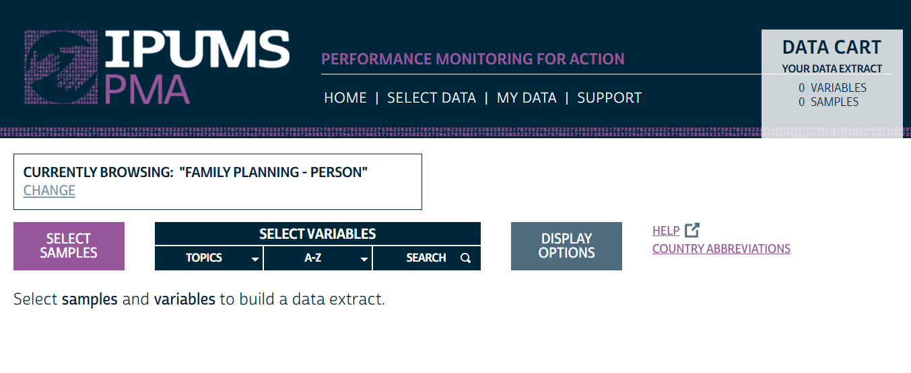

Slide 17
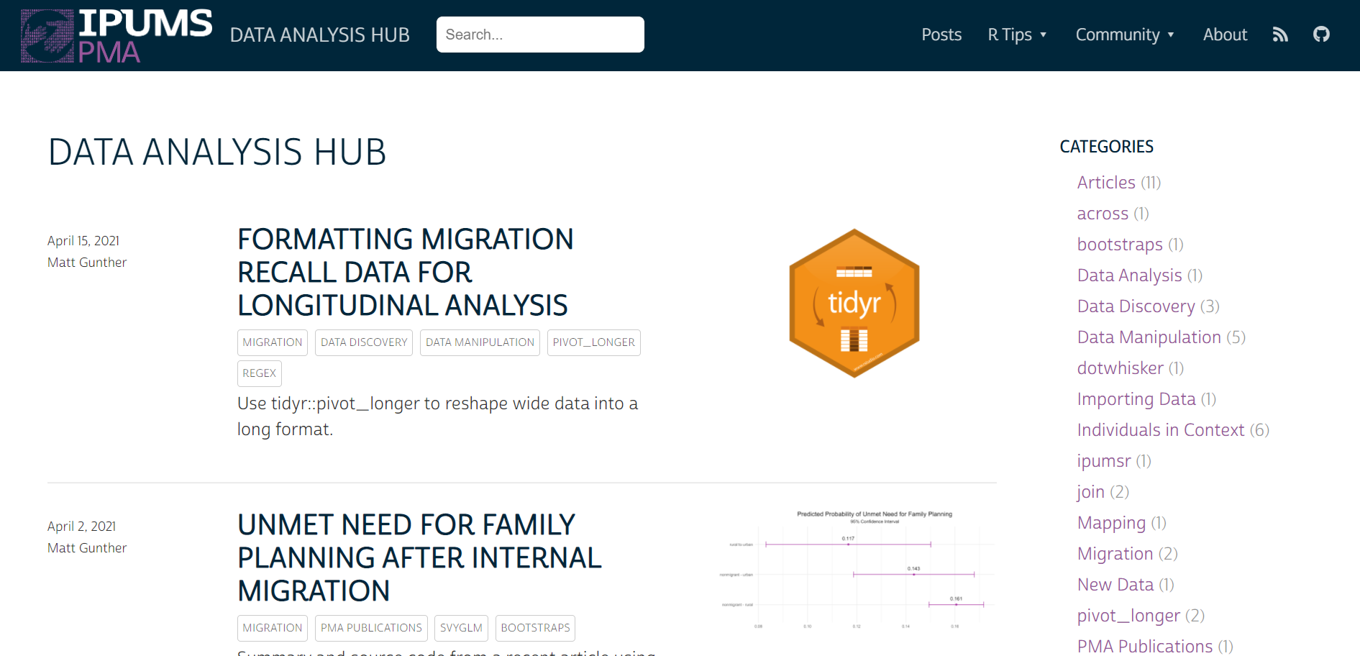

Slide 18
An Introduction to Contraceptive Calendars

Slide 19
Background

Slide 20
History of event/reproductive calendars
First use of a calendar in reproductive health field US National Fertility Survey, 1965
DHS started to incorporate calendar 1980s, most countries now include a 5-year calendar

Slide 21
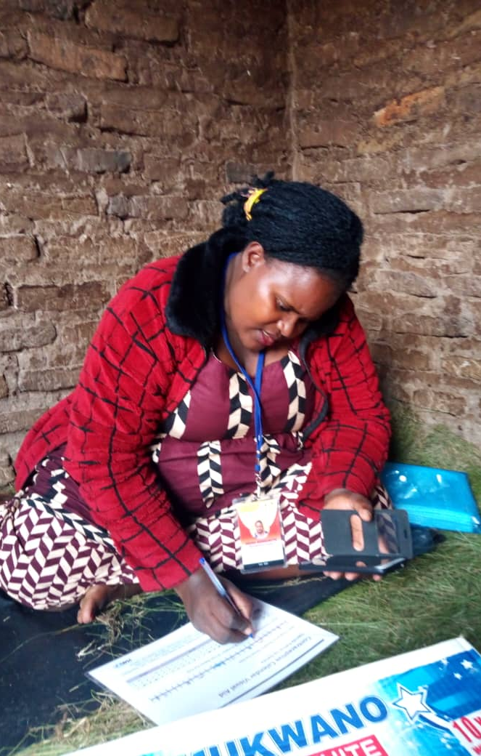
PMA contraceptive calendar
Text Column 1 (Segoe UI, size 16)
Piloted a 5-year calendar in 2017 and a 2-year calendar in 2018
Incorporated a 2-year version into longitudinal design in 2019

Slide 22

PMA contraceptive calendar
PMA calendar is populated from questions during the survey and a drop-down menu at the end of the interview to account for women’s reproductive status during each month
Utilize a visual aid

Slide 23
PMA contraceptive calendar
COL. 1 |  |  | 0 | 0 | 0 | 0 | 0 | 0 | B | P | P | P | P | P | P | P | P | 0 | 5 |  |  |  |  |  |  |  |  |  |  |  |  |  |  |  |  | 5
COL. 2 |  |  |  |  |  |  |  |  |  |  |  |  |  |  |  |  |  |  | 3
 | 12 | 11 | 10 | 9 | 8 | 7 | 6 | 5 | 4 | 3 | 2 | 1 | 12 | 11 | 10 | 9 | 8 | 7 | 6 | 5 | 4 | 3 | 2 | 1 | 12 | 11 | 10 | 9 | 8 | 7 | 6 | 5 | 4 | 3 | 2 | 1
 | DEC | NOV | OCT | SEP | AUG | JUL | JUN | MAY | APR | MAR | FEB | JAN | DEC | NOV | OCT | SEP | AUG | JUL | JUN | MAY | APR | MAR | FEB | JAN | DEC | NOV | OCT | SEP | AUG | JUL | JUN | MAY | APR | MAR | FEB | JAN
 | 2020 |  |  |  |  |  |  |  |  |  |  |  | 2019 |  |  |  |  |  |  |  |  |  |  |  | 2018

Slide 24
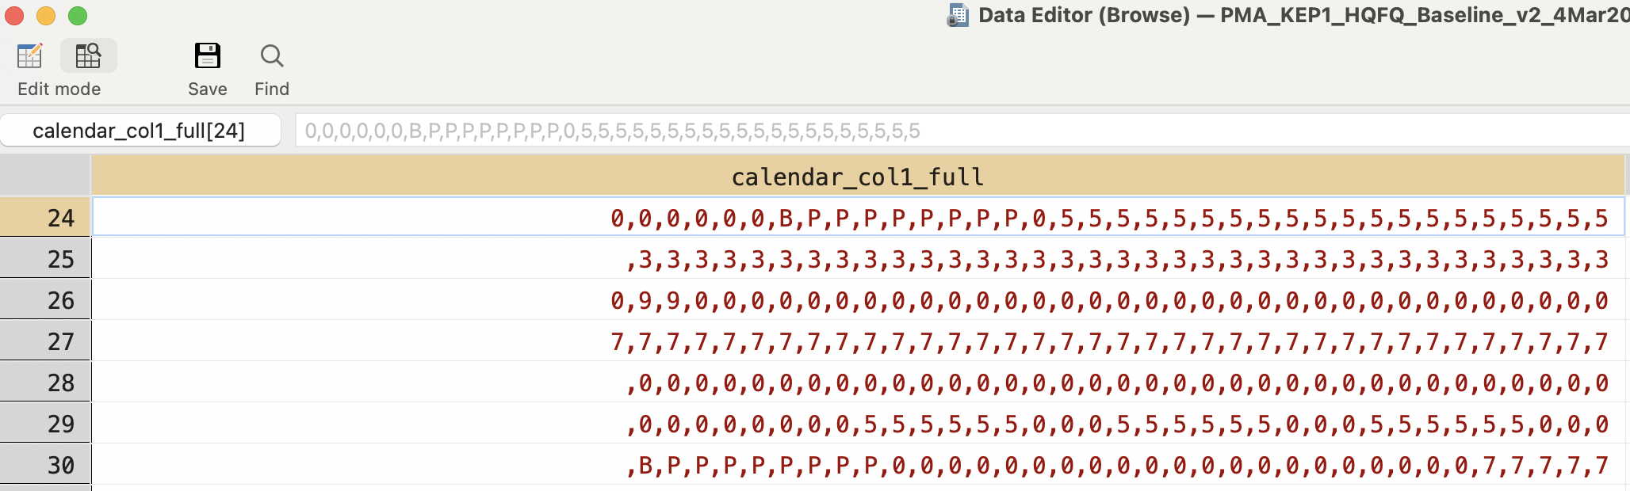
Calendar string

Slide 25
What can be done with calendar data?

Slide 26
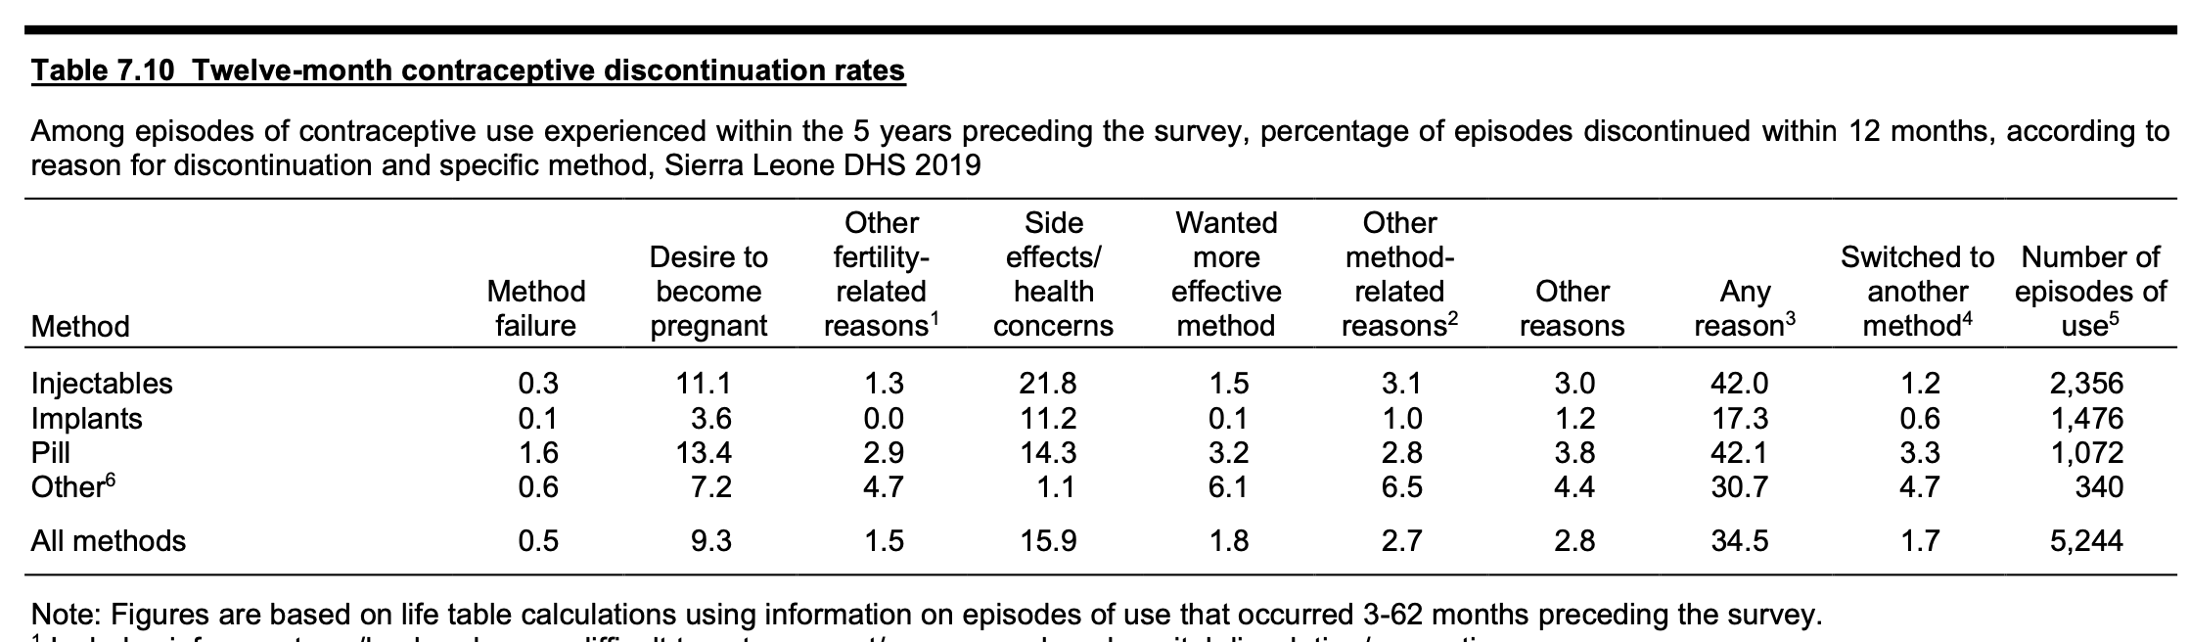
Discontinuation rates
Source: Statistics Sierra Leone (Stats SL) and ICF. 2020. Sierra Leone Demographic and Health Survey 2019. Freetown, Sierra Leone, and Rockville, Maryland, USA: Stats SL and ICF.

Slide 27
Discontinuation rates come from survival curves
Source: DHS Zambia 2018

Slide 28
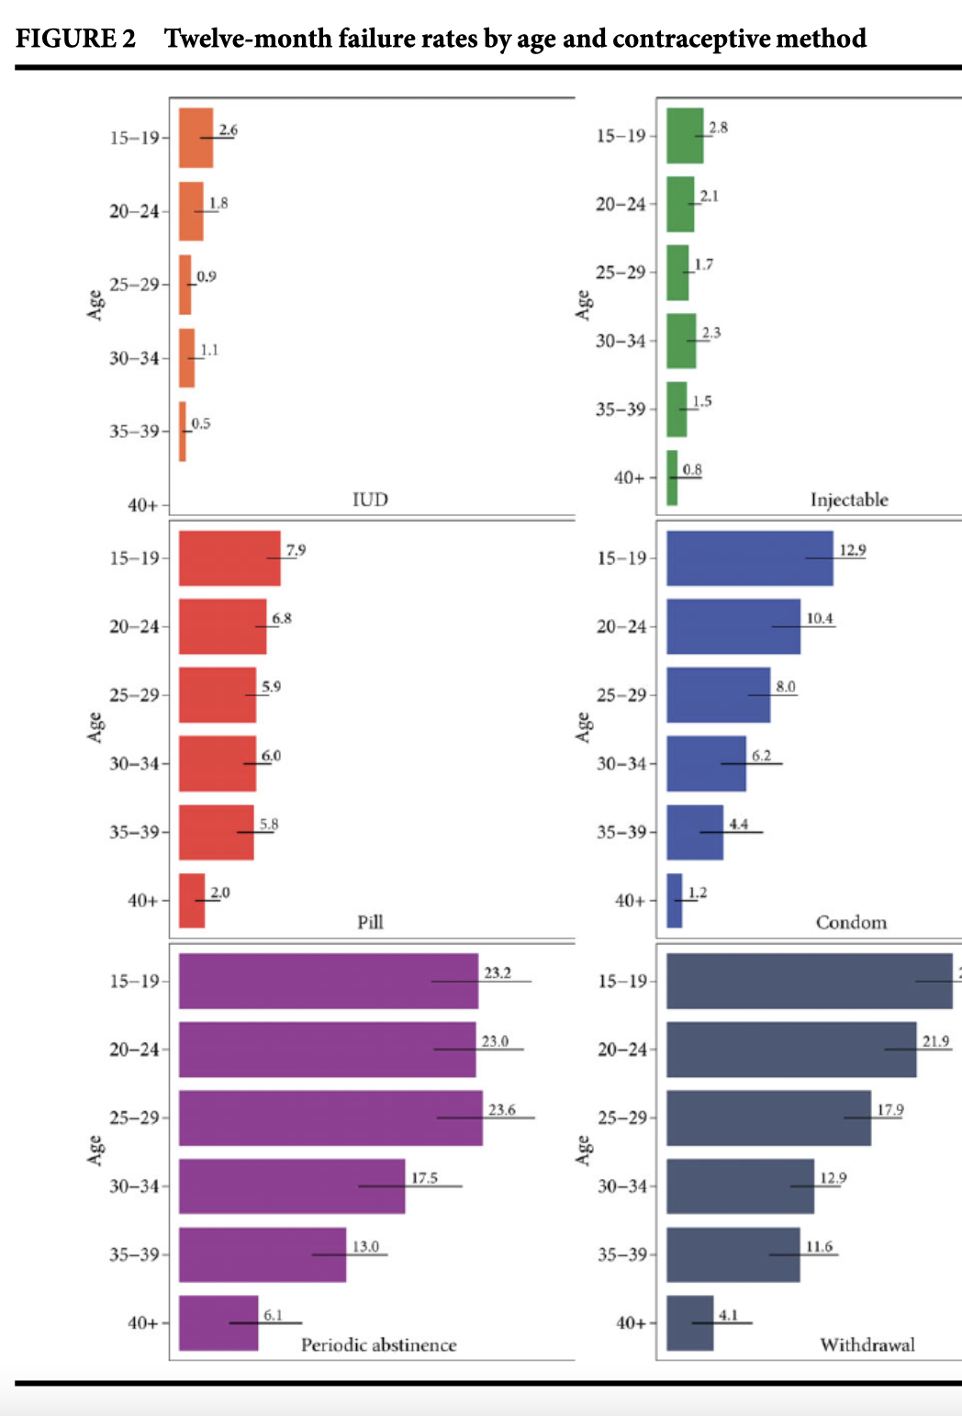
Failure rates
Source: Bradley, S.E., Polis, C.B., Bankole, A. and Croft, T. (2019), Global Contraceptive Failure Rates: Who Is Most at Risk?. Studies in Family Planning, 50: 3-24. https://doi.org/10.1111/sifp.12085
https://www.prb.org/use-dynamics/

Slide 29
Preview:
PMA Longitudinal + calendar data

Slide 30
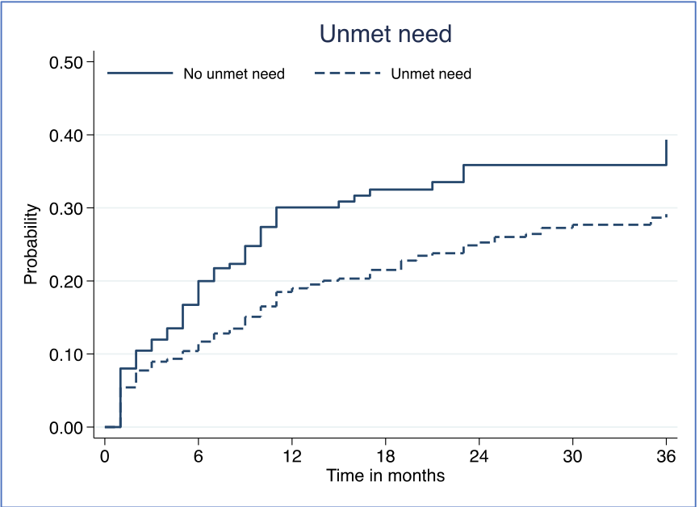
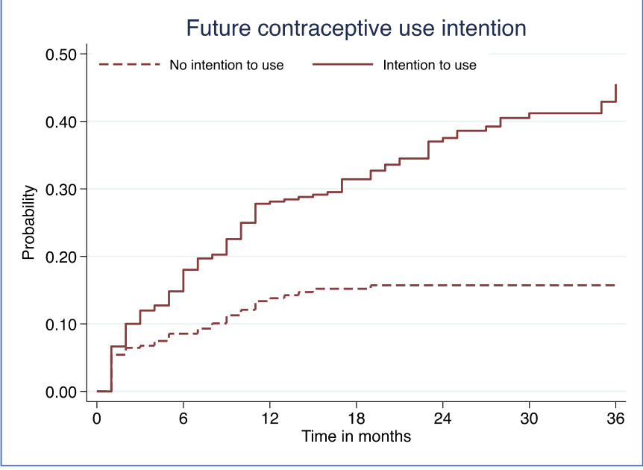
Time to adoption
Text Column 1 (Segoe UI, size 16 or larger)
Text Column 2 (Segoe UI, size 16 or larger)
Source: Sarnak D, Tsui A, Makumbi F, Kibira SPS, Ahmed S. The predictive utility of unmet need on time to contraceptive adoption: a panel study of non-contracepting Ugandan women. Contracept X. 2020 Mar 18;2:100022. doi: 10.1016/j.conx.2020.100022. PMID: 32550537; PMCID: PMC7286181.

Slide 31
Data quality

Slide 32

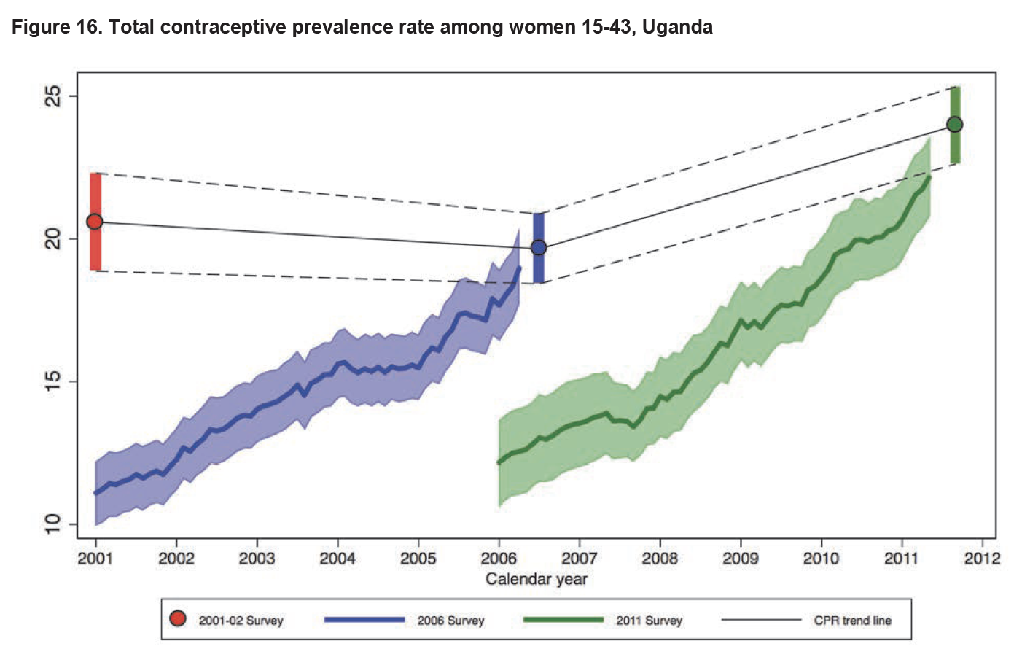
Aggregate level

Slide 33


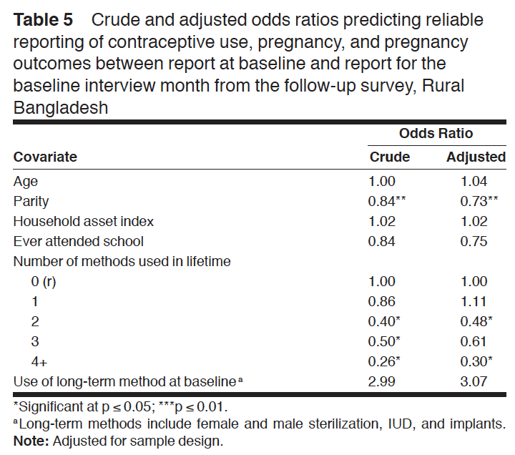
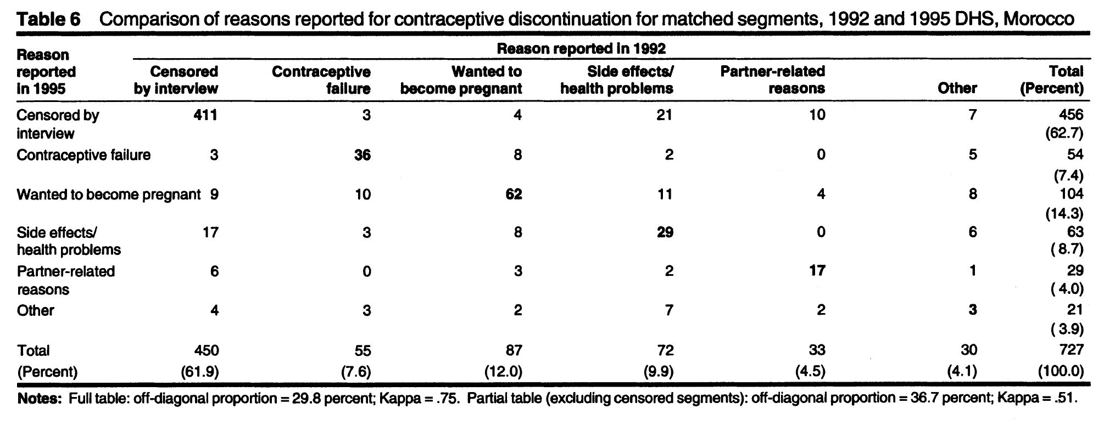
Individual level

Slide 34
How to re-format the string calendar data

Slide 35
Today's Goal
Model "survival" for use of family planning methods

Slide 36
PMA Calendar Data
Reads right to left chronologically
Comma-delimited
Starts January 2017
Nigeria, Kenya
Starts January 2018
DRC, Burkina Faso
Notes:
technical details: reads right to left, which month it starts with

Slide 37
PMA Calendar Data
Person ID | Calendar variable
00000001 | ,,,,,,,,,,,,8,8,8,8,8,8,8,8,8,8,8,8,8,8,8,8,8,8,8,7,7,7,7,7
00000002 | ,,,,,,,,,,,3,3,3,3,0,0,0,0,0,0,0,0,0,B,P,P,P,P,P,P,P,P,0,0,0
00000003 | ,,,,,,,,,,,0,0,0,0,0,0,0,0,0,0,0,0,0,0,0,0,0,0,0,0,0,0,0,0,0
Notes:
picture of what it looks like

Slide 38
Codes
B = Birth P = Pregnant T = Pregnancy ended 0 = No family planning method used 1 = Female Sterilization 2 = Male Sterilization 3 = Implant 4 = IUD 5 = Injectables 7 = Pill
8 = Emergency Contraception
9 = Male Condom 10 = Female Condom 11 = Diaphragm 12 = Foam / Jelly 13 = Standard Days / Cycle beads 14 = LAM 30 = Rhythm method 31 = Withdrawal 39 = Other traditional methods

Slide 39
Parsing the String Data
Stata | R
split calendarke, p(,) gen(cal_ke) | dat %>% separate( col = CALENDARKE, into = paste0("cal_ke", 36:1), fill = "left" )
Notes:
code

Slide 40
After Split/Separate
,,,,,,,,,,,3,3,3,3,0,0,0,0,0,0,0,0,0,B,P,P,P,P,P,P,P,P,0,0,0
cal_ke25 | cal_ke26 | cal_ke27 | cal_ke28 | cal_ke29 | cal_ke30 | cal_ke31 | cal_ke32 | cal_ke33 | cal_ke34 | cal_ke35 | cal_ke36
B | P | P | P | P | P | P | P | P | 0 | 0 | 0
Notes:
What it looks like afterward (table

Slide 41
Changing Format
cal_ke | Month
B | 25
P | 26
P | 27
P | 28
P | 29
P | 30
P | 31
P | 32
P | 33
0 | 34
0 | 35
0 | 36
Wide form
cal_ke25 | cal_ke26 | cal_ke27 | cal_ke28 | cal_ke29 | cal_ke30 | cal_ke31 | cal_ke32 | cal_ke33 | cal_ke34 | cal_ke35 | cal_ke36
B | P | P | P | P | P | P | P | P | 0 | 0 | 0
Long form
Notes:
conceptual change - tables

Slide 42
Changing from Wide to Long
Stata | R
reshape long cal_ke, i(personid) j(month) | dat %>% pivot_longer( starts_with("cal_ke"), names_pat = "cal_ke(.*)", names_to = "MONTH", values_to = "FP" )
Notes:
code

Slide 43
Clean Up
Stata | R
replace month = 37 - month gen numcal_ke = cal_ke replace numcal_ke = "90" if numcal_ke == "P" replace numcal_ke = "91" if numcal_ke == "T" replace numcal_ke = "92" if numcal_ke == "B" destring numcal_ke, replace | dat %>% group_by(ID) %>% mutate(use_m1 = case_when(FP_USE & MONTH == 1 ~ TRUE) %>% any()) %>% filter(use_m1) %>% mutate( non_use_month = case_when(!FP_USE | is.na(FP_USE) ~ MONTH), last_month = ifelse( all(is.na(non_use_month)), 36, min(non_use_month, na.rm = T) - 1 ), right_censored = ifelse(MONTH == 36 & is.na(FP_USE), T, F) %>% any(), ceased = case_when( right_censored & last_month == 35 ~ F, last_month == 36 ~ F, last_month < 36 ~ T ) ) %>% filter(last_month == MONTH) %>% survfit(Surv(last_month, ceased) ~ 1, data = .)

Slide 44
Survival Analysis
Statistical analysis of duration of time before an event (“fail”)
Women using FP in month 1 (fp_use == 1)
Estimating time until stop (fp_use == 0)

Slide 45
Recoding Key Variables
Stata | R
recode numcal_ke (0=0) (90/92=0) (else=1), gen(fp_use) | dat %>% mutate( FP_USE = !FP %in% c( "B", "P", "T", "0" ), MONTH = as.integer(MONTH) )
Notes:
code

Slide 46
Survival Curve
Stata | R
stset month, id(personid) failure(fp_use==0) sts graph | autoplot(dat)
Notes:
code

Slide 47
Questions?

Slide 48
Coming soon:
Public access of PMA longitudinal data
Notes:
Today we have focused on contraceptive calendar data, which, as others described, collects retrospective data on contraceptive use
PMA also conducts prospective studies in which we follow women and collect data related to RMNH. During the next couple of minutes I will review the longitudinal study designs for PMA. Note: longitudinal = panel
I will also review the schedule that PMA releases longitudinal data

Slide 49
PMA Panel Design
Panel Enrollment
+ Age-in
Move-in/out
+ Age-in
Move-in/out
YR1
YR2
YR3
Open Panel Design
Household
Panel
X-section + panel results
Panel results
X-section results
Linked
Linked
Linked
Private
YR1
6 mo.
YR2
6 mo.
YR3
Public
SDP
Panel
SDP interview + client exit interview
SDP + CEI
SDP + CEI
Notes:
REINFORCE AND ADD TO INTRO EARLIER IN EVENT; FOCUS ON LONGITUDINAL DATA
Reminder: PMA Core follows women of reproductive age in order to collect data on contraceptive dynamics. Women are enrolled and followed for two years, with interviews at baseline, at 1 year, and at 2 years.

Slide 50


PMA Ethiopia Panel Design
Panel Enrollment & Cross-Section
Second Cross-Section
Cross-section & end of first cohort
2019
Follow-up of pregnant and postpartum women
2020
6-weeks, 6-months and one year postpartum
2021
Individual
Panel
X-section + panel results
6-week and preliminary 6-month results and year 2 cross section results
X-section results
Private
2019
2020
2021
Public
SDP
Notes:
REINFORCE AND ADD TO INTRO EARLIER IN EVENT; FOCUS ON LONGITUDINAL DATA
In addition to conducting cross-sectional surveys of women of reproductive age and surveys of Service Delivery Points, PMA Ethiopia also conducts a panel survey of pregnant women and follows them through one-year postpartum. The data we collect help us understand health and care-seeking of women in Ethiopia from pregnancy to one-year postpartum. We are generating datasets, which will be publicly available, that include information about women when they enroll in the study, at 6 weeks postpartum, 6 months postpartum, and 1 year postpartum. Data users can link these datasets across time with an identifier for the woman respondent.

Slide 51
PMA longitudinal data: Spring 2022
Burkina Faso, DRC, Kenya, Nigeria
Phase 1 and Phase 2 following women of reproductive age
Ethiopia
Cohort 1 following pregnant women through one-year postpartum
Notes:
Note that PMA Ethiopia baseline and 6 week postpartum follow up data are available now
Describe all the longitudinal data that will be available a year from now
Mention IPUMS timeline?
Everything will be made publicly available eventually, but this is what you can expect by next spring
In order to help researchers access and understand PMA longitudinal data, we plan to hold another PAA side event next year. We will send info to everyone who signed up for this webinar when the time comes. Stay tuned!

Slide 52
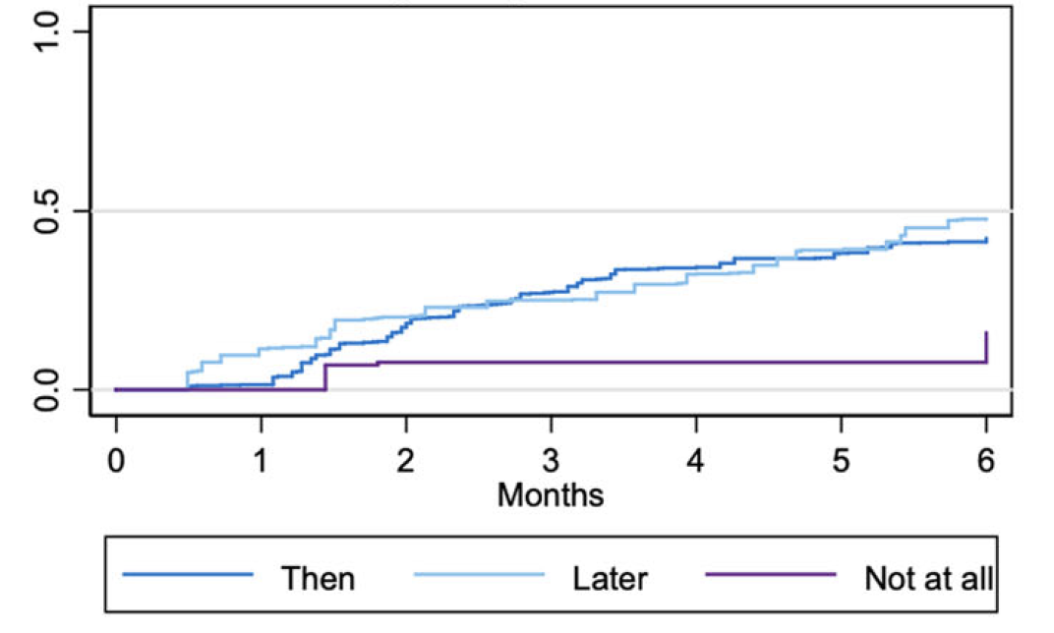
PMA Ethiopia: Uptake of a contraceptive method over the six month postpartum period
Kaplan-Meier failure function by pregnancy wantedness
Source: Zimmerman L, Yuanyuan Y, Yihdego M, Abrha S, Shiferaw S, Seme A, Ahmed S. Effect of integrating maternal health services and family planning services on postpartum family planning behavior in Ethiopia: results from a longitudinal survey. BMC Public Health (2019) 19, 1448. https://doi.org/10.1186/s12889-019-7703-3
Notes:
Sneak peek/reminder, relate back to Dana’s example

Slide 53
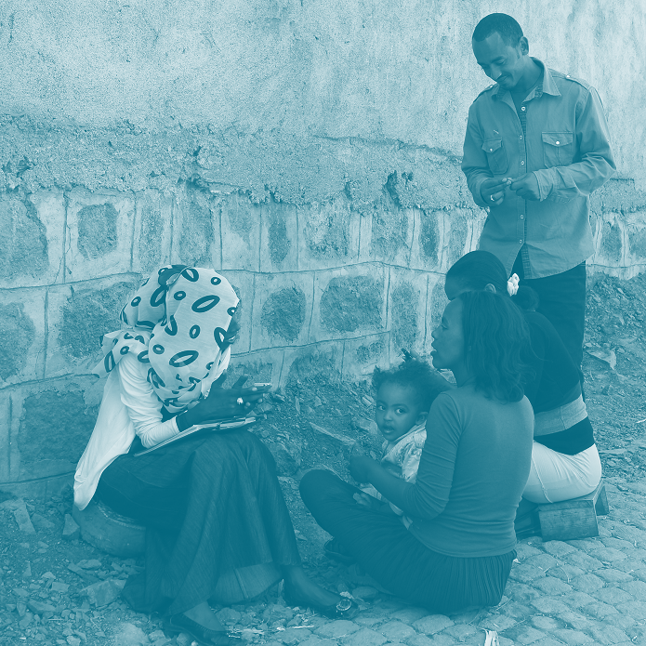




Thank you!
pmadata.org
/pm4action
@pm4action
@pm4action
Notes:
To change the photo, click on the photo and delete it. Then click on the icon and select a new photo from your computer.

